Slide 1


Research report Presentation
Predictive Pricing Dynamics for Short-Term Rent: An Integrated Approach to Host Clustering and Price Prediction
Presented by: Group 3
Anjali Khanal
Coto Nagamine
Ha Nguyen
Samip Khand Thakuri
Dec 5, 2024

Slide 2

Executive Summary
This research project aims to develop an integrated approach to analyzing Airbnb listing prices in New York City by combining host clustering analysis with price prediction modeling.

Slide 3


Agenda Overview
01
Introduction
05
Methodologies
02
Problem Statement
06
Limitations
03
Objectives
07
Future Work
04
Literature Reviews
08
Conclusion

Slide 4

Introduction
Airbnb's Impact: Enables homeowners to earn income through short-term rentals, while presenting challenges in competitive pricing due to various influencing factors.
Study Purpose: Analyze the New York City Airbnb dataset to identify key predictors affecting pricing.
Methodology: Employ clustering and predictive modeling techniques to uncover insights into pricing influences.

Slide 5



Problem Statement
Scope of the Study
This study focuses on analyzing Airbnb listings in New York City to determine the key factors that influence rental prices
Research Question
What are the key features that significantly impact the price of short-term rental listings?
How can insights from the model's predictions inform hosts' pricing strategies?
To what extent does machine learning provide answers to these critical questions?

Slide 6



Objectives
Determine and analyze the most pronounced determinants of price of Airbnb listings
Assess the performance of the formulated models in predicting Airbnb prices, as well as investigate the effectiveness of incorporating clustering compared to the pure regression model in price prediction prowess.
Provide actionable insights to allow hosts to optimize their price-setting

Slide 7

Literature Review

Slide 8
Price Predictions
Name | A Sustainable Price Prediction Model for Airbnb Listings Using Machine Learning and Sentiment Analysis Alharbi ZH. (2023) | Price determinants of sharing economy based accommodation rental: A study of listings from 33 cities on Airbnb.com Wang, D., & Nicolau, J. L. (2017). | Reviews and price on online platforms: Evidence from sentiment analysis of Airbnb reviews in Boston. Lawani, A., Reed, M. R., Mark, T., & Zheng, Y. (2019)
Method | Employed multiple advanced models: Lasso, Ridge, KNN, Decision Tree Regression across 191 countries | Used OLS and Quantile Regression analysis to analyze 25 variables across 33 cities | Innovative approach combining regression and sentiment analysis of textual data
Findings | Number of beds and guest accommodation capacity consistently ranked as top pricing factors | 5 key categories of price predictors: host, property, amenities, rules, reviews | Highlighted importance of comprehensive data approach in price predictions

Slide 9
Host Clustering
Name | The impacts of quality and quantity attributes of Airbnb hosts on listing performance. Xie, K. L., & Mao, Z. (2017) | When guests trust hosts for their words: Host description and trust in sharing economy Tussyadiah, I. P., & Park, S. (2018)
Method | Gamma-LaPlace Penalties in Clusterings, Variational Em Expectation-Maximization | TOSCA Clustering for foming density based clusters
Findings | 2 latent traits: host-focused vs property-focused and 4 groups of reviews: neutral, positive, negative, compound | Identified 30 clusters as the optimal Price varies significantly even between clusters with close proximity Key findings: Price is influenced by the moderness of the area

Slide 10
Methodology

Slide 11
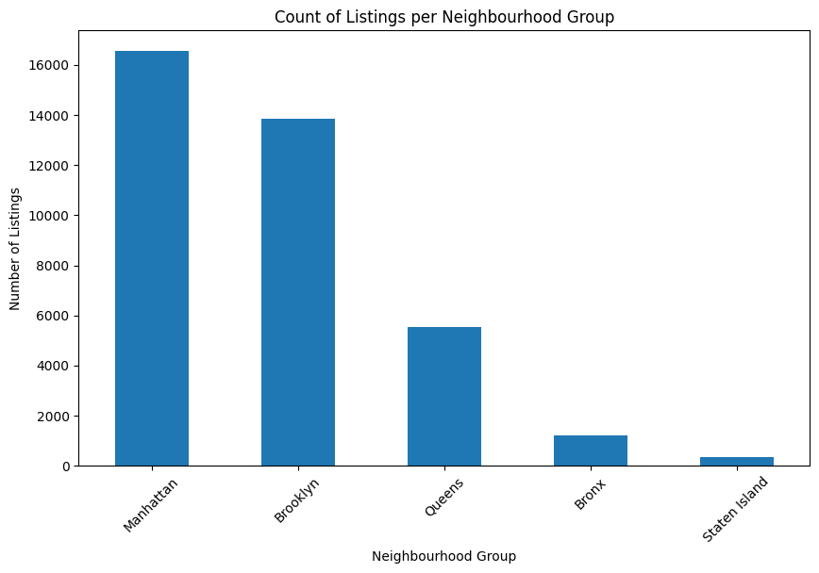
EDA
Manhattan and Brooklyn have the highest listings.
Queens is in rank third with medium activity.
Bronx and Staten Island have the lowest listings.
Figure 1. Distribution of Neighborhood Group

Slide 12
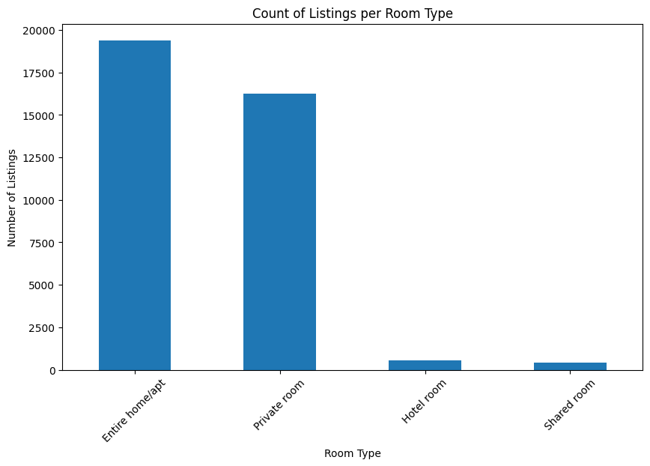
Entire home/apt have the highest number of listings.
Private rooms comes second, still have high demands.
Hotel rooms and shared rooms have fewer listings.
Figure 2. Distribution of Room Type

Slide 13
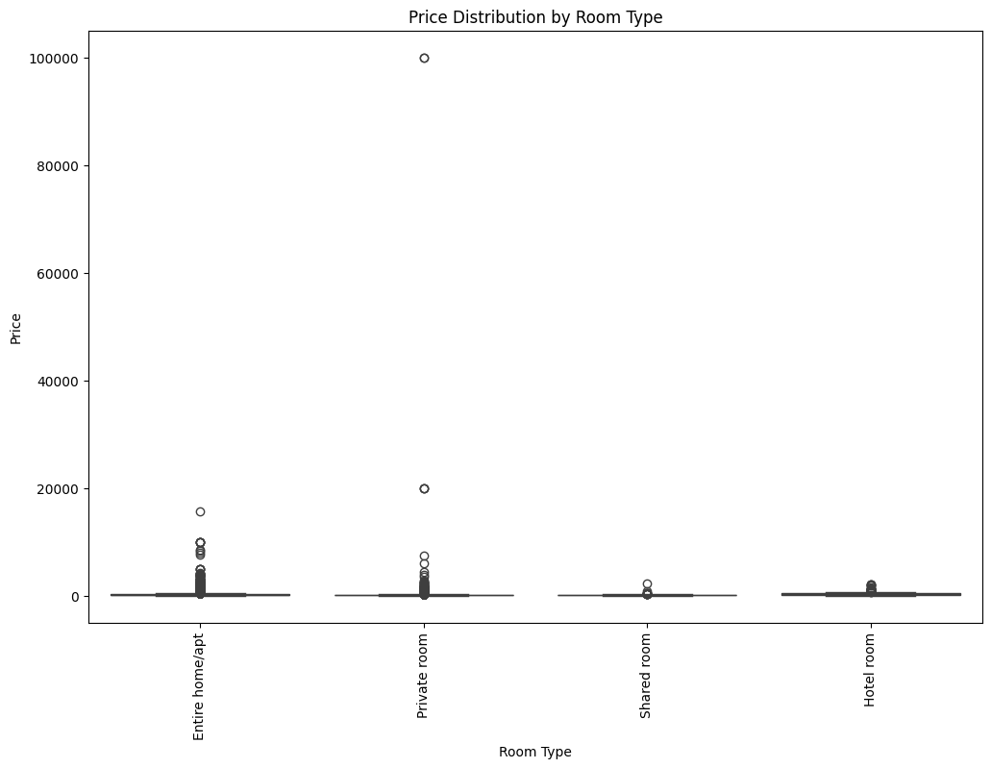
Entire homes/apts have highest prices then any other
Private rooms have medium price, with some outliers.
Shared rooms and hotel rooms have the lowest prices.
Outliers are present in entire home/apt and private rooms.
Figure 3. Room Type vs Price

Slide 14
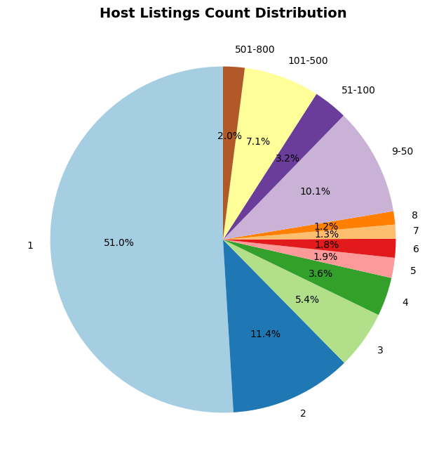
51% of hosts have only one listing, indicating presence of individual hosts.
A wide range of host have multiple listings with significant portions.
smaller hosts have a substantial number of listings, in 501-800 and 101-500 categories.
Figure 4. Distribution of calculated_host_listings_count

Slide 15
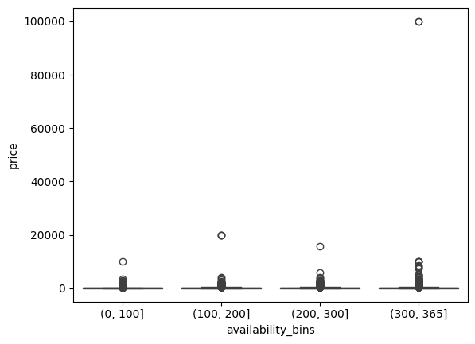
plot shows the distribution of prices across different availability bins.
outliers with very high prices, in the higher availability bins.
slight trend of increasing prices with higher availability, but relationship is not strong.
Figure 5. Availbility_bins vs price

Slide 16
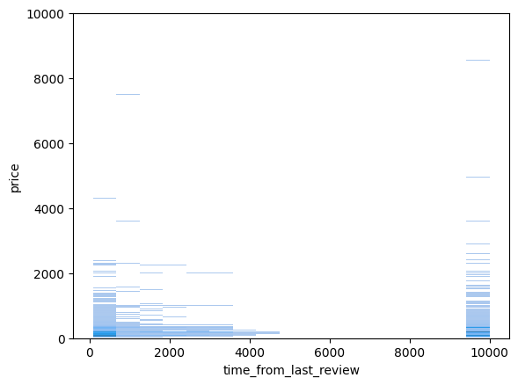
plot shows the distribution of prices based on the time since the last review.
very high price outliers with very high prices in higher time-since-last-review ranges.
most price are in lower ranges with fewer listing in higher price bracket.
slight trend of increasing prices with longer time since the last review, but relationship is not very strong.
Figure 6. Time_from_last_review vs Price

Slide 17
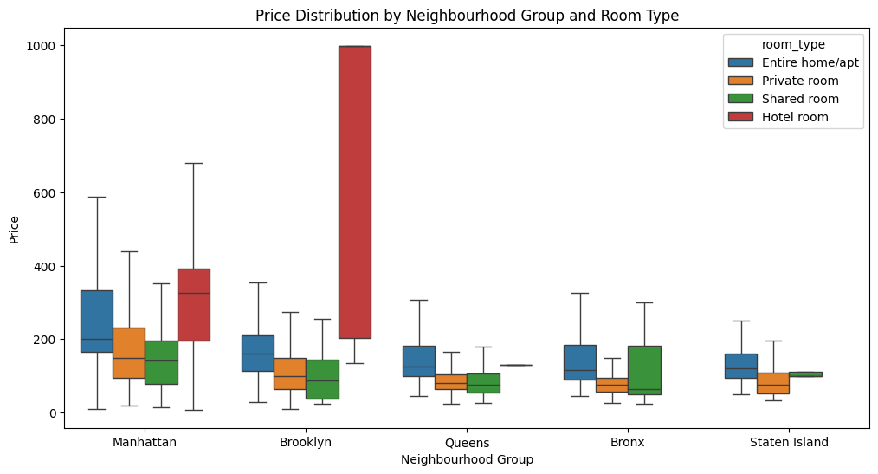
price of accommodation varies with different room types and neighborhoods.
Entire house/apt has higher prices, in Manhattan and Brooklyn.
Shared Rooms is affordable in all neighborhoods
Some outliers in higher price ranges for certain room types and neighborhoods.
Figure 7. Interaction between room type, neighbourhood groups,
and price

Slide 18
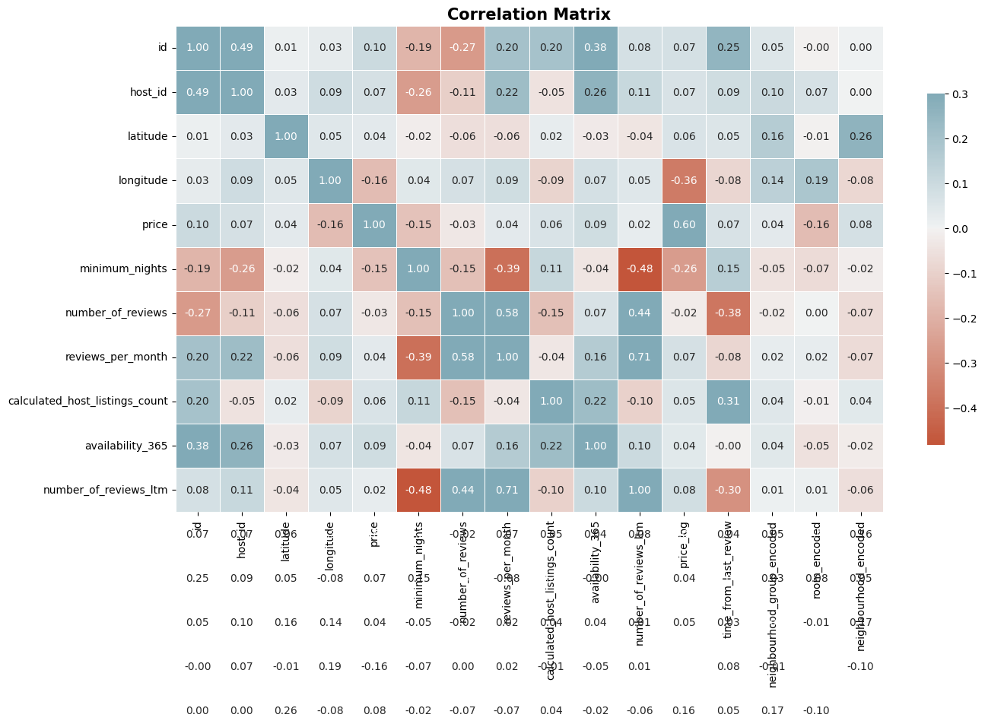
Positive Relationships:
More listings correlate with more reviews
Higher minimum nights correspond to higher prices.
more reviews tend to have better ratings.
Negative Relationships:
Properties for longer periods have lower prices.
Weak Correlations:
variable with weak relationships, indicate less influence on each other.
Figure 8. Correlation Matrix

Slide 19
Outliers and Missing Values
OUTLIERS
Price, minimum nights, number of reviews
Listing with prices over $100,000
Values above the 99th percentile
Missing Values
Numerical Data (median)
Categorical Data (mode)

Slide 20
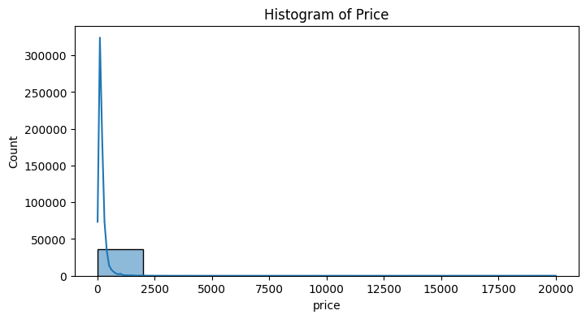
Price Normalization and Feature Engineering
time_from_last_review was created to capture the effect of review timeliness on price.
price distribution is heavily right-skewed, a long tail of higher-priced listings.
lower price range listing, with a few outliers at higher prices.
outliers suggests that there is luxury or unique properties with high prices.
Figure 9. Skewness of Price

Slide 21
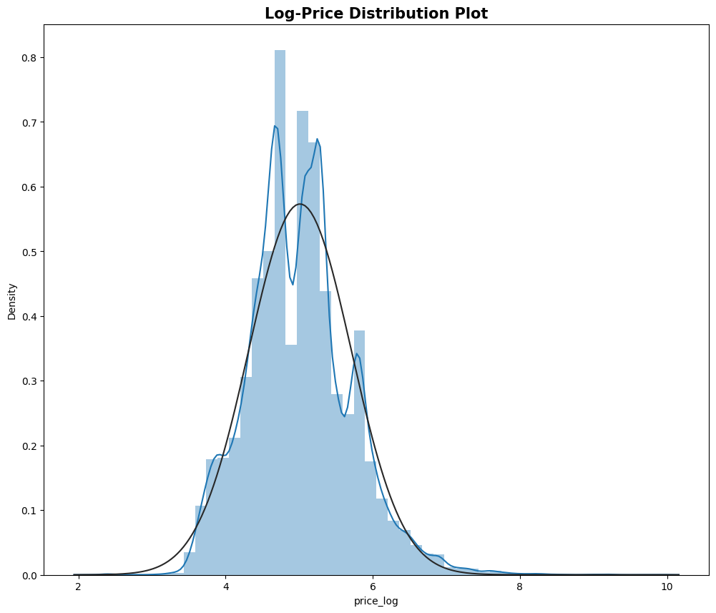
Log transformation makes the price distribution more normal making it more bell-shaped
Log-transformed prices follow a normal distribution.
Normalization slightly reduces outliers, but some remain.
Figure 10. Price Normalization

Slide 22
Results

Slide 23
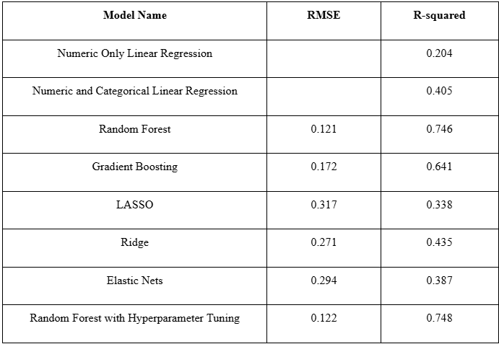
Model Selection and HyperParameter Tuning
Linear Regression baseline model revealed initial feature-price relationships
Gradient Boosting addressed nonlinear interactions but underperformed
Regularization techniques mitigated multicollinearity and perform feature selections
Random Forest emerged as superior model with highest R² of 0.746
359 trees, a maximum depth of 40, and at least 4 samples per split

Slide 24
Feature Importance - Base Model
Ranking | Feature Name | Score
1 | longitude | 0.3350
2 | latitude | 0.1639
3 | calculated_host_lisitngs_count | 0.1112
4 | availability_365 | 0.1046
5 | room_type_Private room | 0.1046
Geographic coordinates dramatically influence Airbnb pricing across New York City neighborhoods.
Hosts with multiple listings strategically price properties based on portfolio experience.
Room type and availability significantly determine the final listing price range.

Slide 25
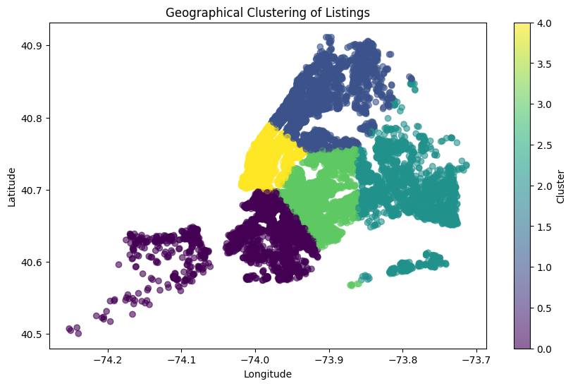
Cluster Analysis
Geo_cluster | Description | Mean Price (log) | Mean Price (USD)
0 | Urban Core - Mid-Priced | 4.855197 | 128.405
1 | Affordable Urban | 4.778366 | 118.90
2 | Suburban Budget Friendly | 4.653657 | 104.97
3 | Transitional Zone | 4.705453 | 110.55
4 | Central - High Price | 5.505788 | 246.11

Slide 26
Applying Random Forest to Clusters
Cluster | RSME | R-Squared
0 | 0.1607 | 0.6000
1 | 0.1336 | 0.6093
2 | 0.1210 | 0.6456
3 | 0.1131 | 0.6713
4 | 0.1859 | 0.4692
Cluster 3 shows best model performance with lowest MSE and highest R-squared
Clusters 0 and 1 demonstrate consistent predictive capabilities
Cluster 2 exhibits weakest performance with lowest R-squared value
The results of applying Random Forest to Clusters

Slide 27
Applying Random Forest to Clusters
Cluster | Feature 1 | Feature 2 | Feature 3
4 | Calculated_host_ listings_count | longitude | availability_365
0 | latitude | Room_type _Private room | longitude
1 | room_type_Private room | latitude | longitude
3 | room_type_Private room | Calculated_host_ listings_count | availability_365
2 | latitude | room_type_Private room | longitude
Cluster 4: Host listing count, longitude, and availability drive pricing
Cluster 0 and 2: Geographical location and room type most influential
Cluster 1 and 3: Private room type consistently impacts pricing across segments
Clusters’ Feature Importance

Slide 28
Applying Linear Regression to Clusters
Cluster 4
R-squared: 0.205
Key Features:
Longitude: -6.36
(Significant, p-value = 0.000)
Minimum Nights: -0.0166
(Significant, p-value = 0.000)
Calculated Host Listings Count: 0.0004
(Significant, p-value = 0.000)
Cluster 0
R-squared: 0.356
Key Features:
Latitude: 5.83 (Significant, p-value = 0.000)
Longitude: -3.15 (Significant, p-value = 0.000)
Private Room: -0.459 (Significant, p-value = 0.000)

Slide 29
Applying Linear Regression to Clusters
Cluster 1
R-squared: 0.377
Key Features:
Latitude: -5.14 (Significant, p-value = 0.000)
Longitude: -2.33 (Significant, p-value = 0.000)
Private Room: -0.456 (Significant, p-value = 0.000)
Cluster 3
R-squared: 0.384
Key Features:
Latitude: 2.60 (Significant, p-value = 0.000)
Longitude: -3.70 (Significant, p-value = 0.000)
Private Room: -0.495 (Significant, p-value = 0.000)
Notes:
host reputation and reliability

Slide 30
Applying Linear Regression to Clusters
Cluster 2
R-squared: 0.300
Key Features:
Latitude: -2.23 (Significant, p-value = 0.000)
Private Room: -0.441 (Significant, p-value = 0.000)
Shared Room: -0.484 (Significant, p-value = 0.000)
Implications for Pricing:
Geography: The impact of longitude and latitude suggests that listings in central, high-demand locations can command significantly higher prices.
Room Type: "Private rooms" are a major factor in determining price across all clusters.
Host Experience: More experienced hosts generally command higher prices.

Slide 31
Model Evaluation
OOB Score | MSE | R²
0.707559 | 0.122798 | 0.744
Figure 25. OOB Results
Out-of-Bag score of 0.708 validates robust Random Forest model performance
Mean Squared Error of 0.123 indicates high predictive accuracy
R-squared of 0.744 shows model explains 74.4% of price variation

Slide 32
Discussion

Slide 33
Key Findings and Insights
Geography: Latitude and longitude play critical roles in pricing.
Room Type: Entire homes and hotel rooms have the highest prices.
Host Experience: More listings and availability lead to higher prices.
Actionable Insight:
Cluster 4 Hosts in prime locations should prioritize availability year-round and having multiple listings.
Cluster 0 and 1 Hosts should focus on having Private room options and the seasonality (campus visits, breaks, etc.) to remain competitive
Cluster 3 Hosts should make availability and the option for private rooms as well as the abundance of reviews their focus
Cluster 2 Hosts with listings further away from the city should leverage the key amenities around their listings as

Slide 34
Limitations
Dataset Limitations
Feature Limitations
Clustering Limitations
Missing Data and Outliers

Slide 35
Future Work
Incorporating Real-Time Data
Cross-Regional Analysis
Enhanced Feature Engineering
Advanced Clustering and Segmentation
Integration of External Data
Price Optimization Framework

Slide 36
References
Alharbi ZH. (2023). A Sustainable Price Prediction Model for Airbnb Listings Using Machine Learning and Sentiment Analysis. Sustainability, 15(17):13159.
Forge, D.,
Lawani, A., Reed, M. R., Mark, T., & Zheng, Y. (2019). Reviews and price on online platforms: Evidence from sentiment analysis of Airbnb reviews in Boston. Regional Science and Urban Economics, 75, 22-34.
Wang, D., & Nicolau, J. L. (2017). Price determinants of sharing economy based accommodation rental: A study of listings from 33 cities on Airbnb.com. International Journal of Hospitality Management, 62, 120-131.

Slide 37
Thank You

